Slide 1
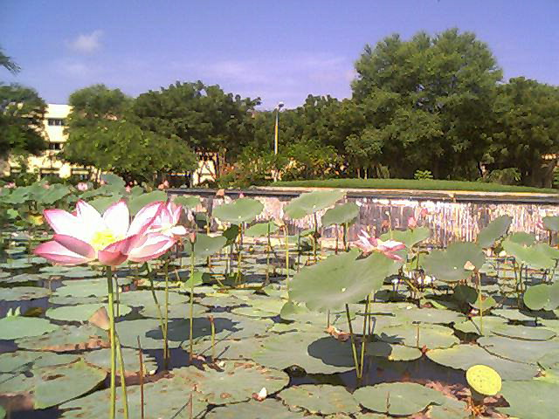
SC205 Class 5

Slide 2


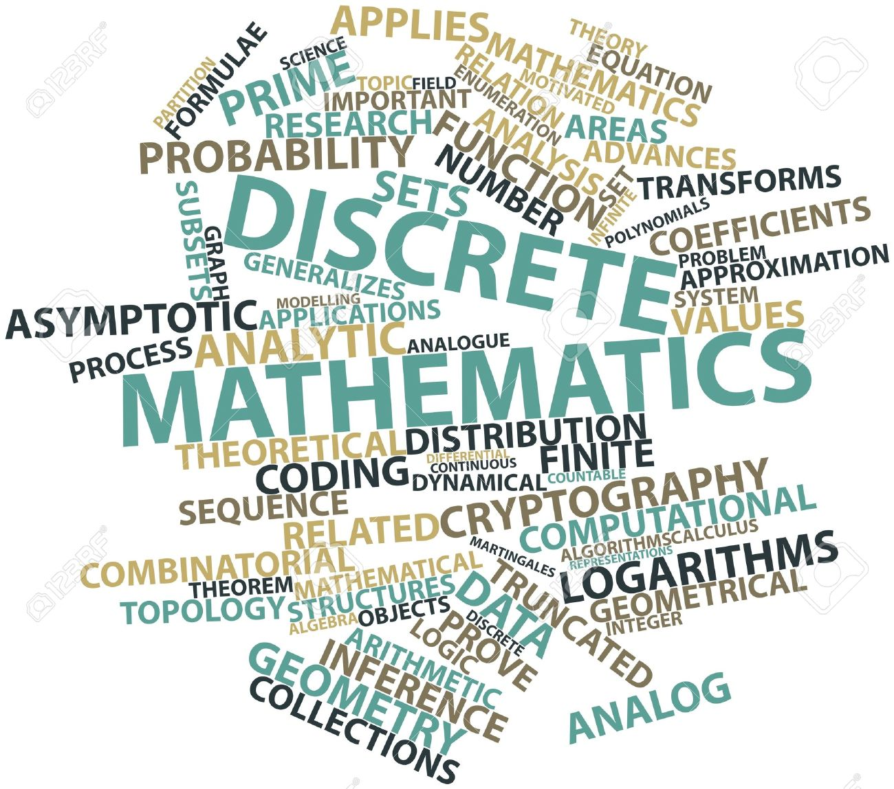
SC 205 A Discrete Mathematics
Lecture 5: Logic
Prof. Manish K. Gupta
https://www.onlinebooksreview.com/articles/best-discrete-mathematics-books
SC205 Class 5

Slide 3
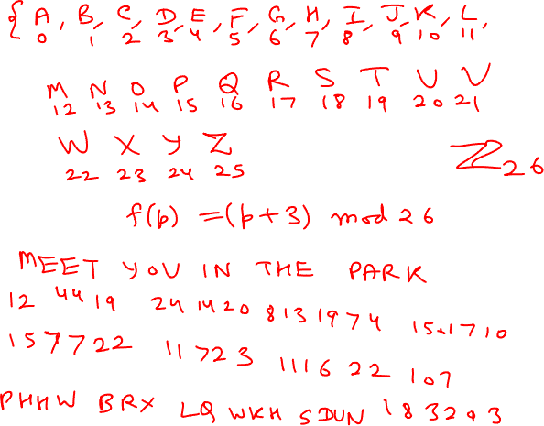
SC205 Class 5

Slide 4
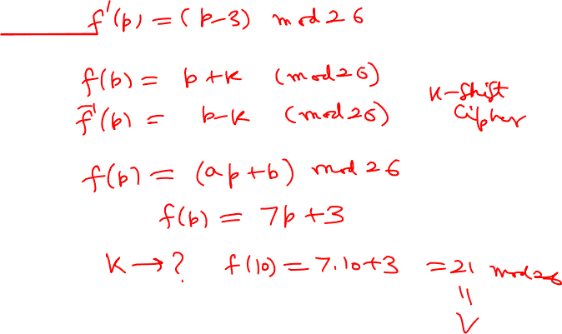
SC205 Class 5

Slide 5
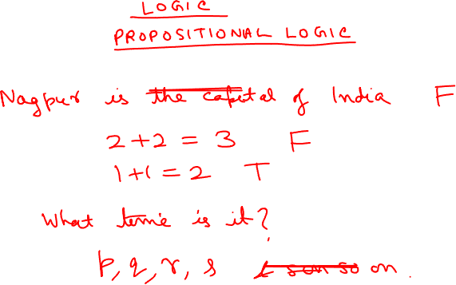
SC205 Class 5

Slide 6
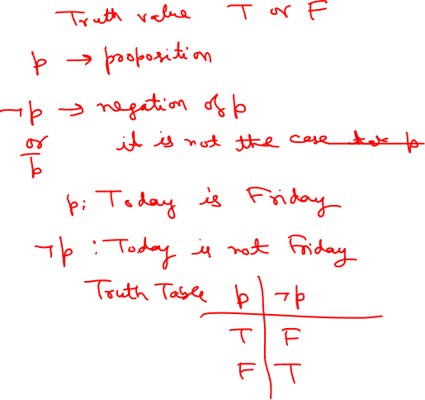
SC205 Class 5

Slide 7
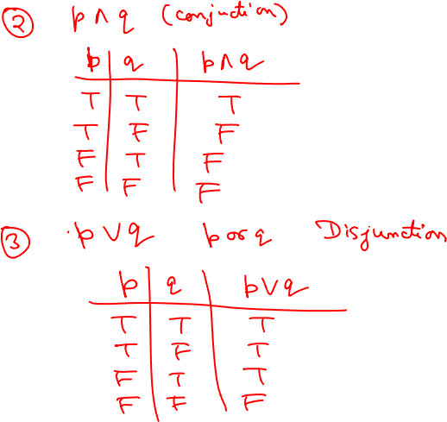
SC205 Class 5

Slide 8
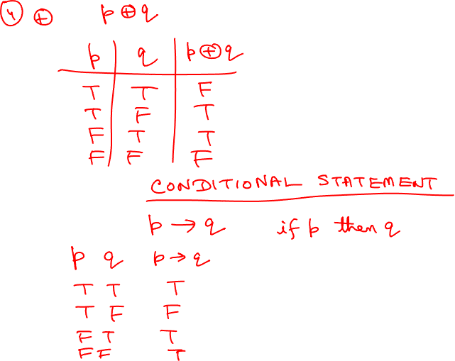
SC205 Class 5

Slide 9
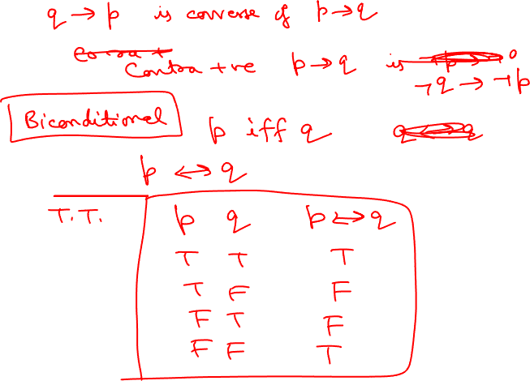
SC205 Class 5

Slide 10
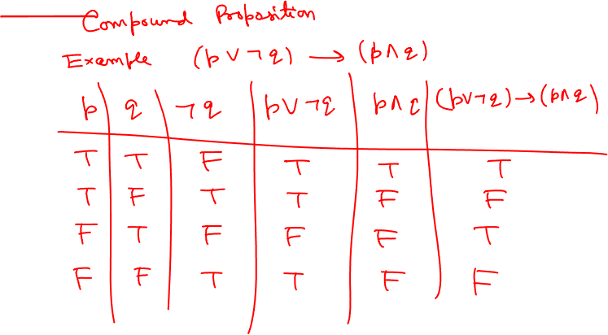
SC205 Class 5

Slide 11
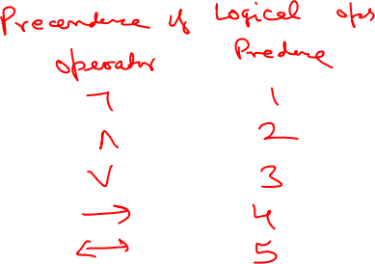
SC205 Class 5

Slide 12
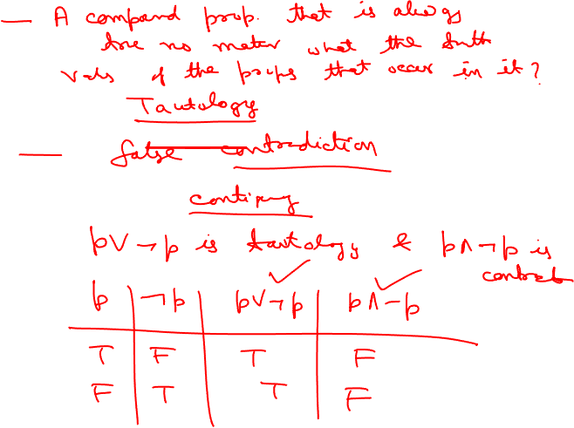
SC205 Class 5

Slide 13
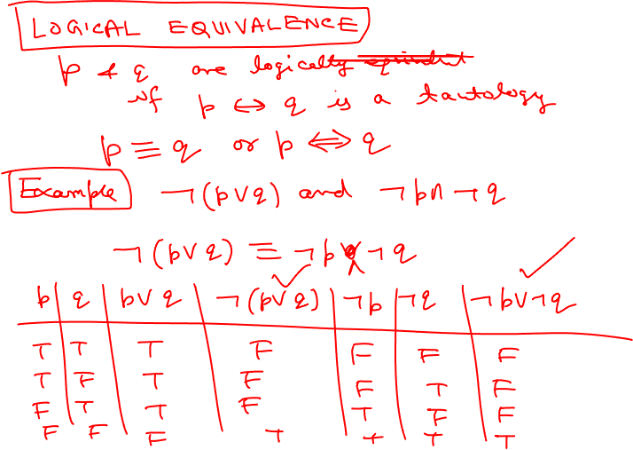
SC205 Class 5

Slide 14
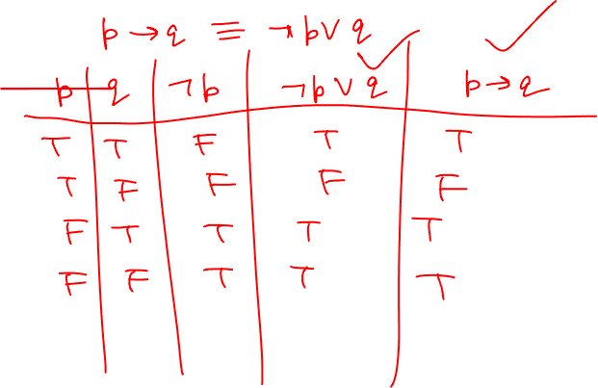
SC205 Class 5

Slide 15
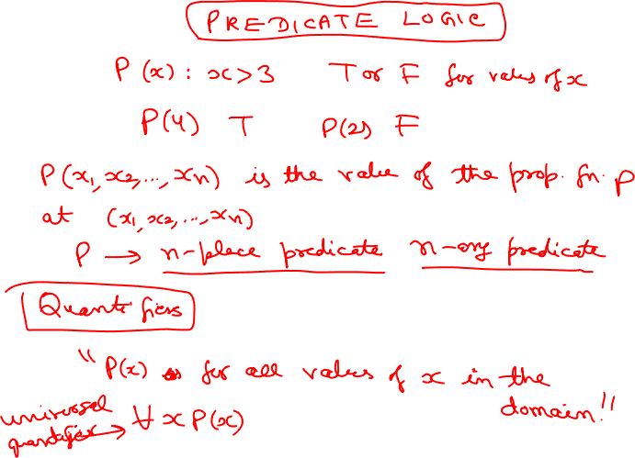
SC205 Class 5

Slide 16
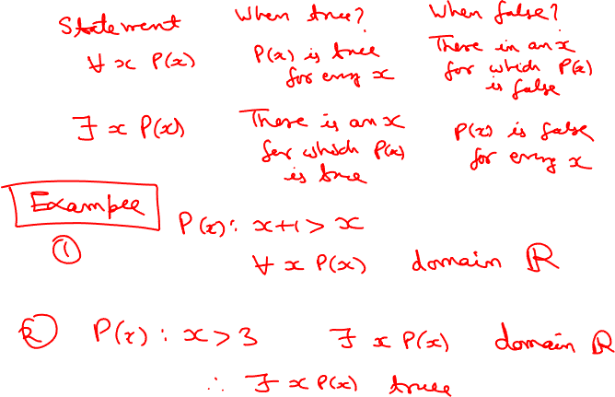
SC205 Class 5

Slide 17
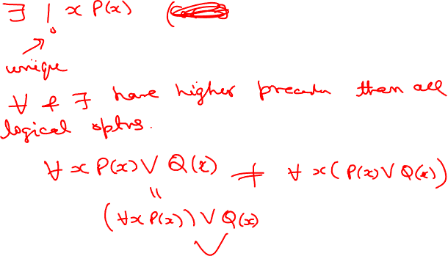
SC205 Class 5

Slide 18
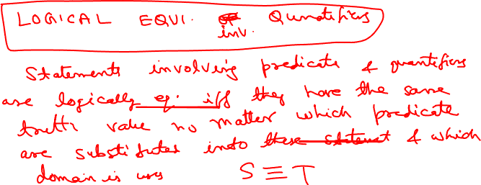
SC205 Class 5

Slide 19
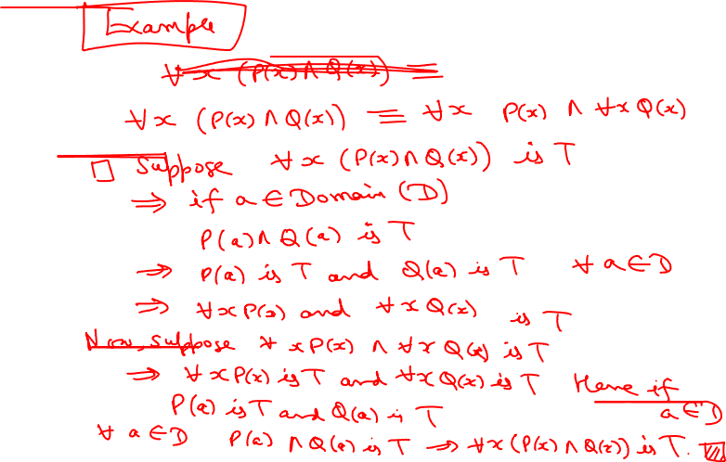
SC205 Class 5

Slide 20
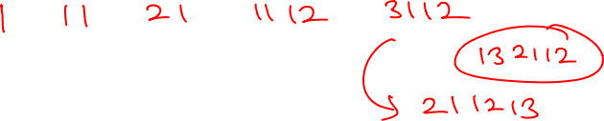
SC205 Class 5

Slide 21
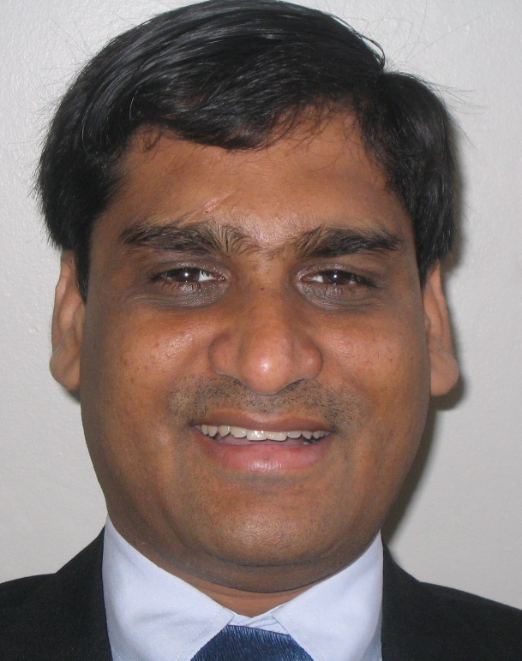
Profile of Manish K Gupta, PhD IIT Kanpur
International and interdisciplinary working experience of more than 28 years in 8 countries such as USA, Canada, Germany, Singapore, New Zealand, South Korea, Saudi Arabia and India.
Generated funding worth more than INR 30 million (Rs 3 crore)
Founder of DA-IICT Centre for Entrepreneurship and Incubation (a section 8 not for profit company) which incubated 19 start-ups/companies from 2007
Founder of Guptalab which produced well known 11 softwares in DNA nanotechnology
DNA storage project shortlisted as top 5 innovation for Prime Minister (India and Israel) demo at India Israel Innovation Initiative, Jan 2018, iCreate Campus, Deo Dholera, Gujarat, India
Featured Reviewer ACM Computing Review February 2016 Issue
IEEE Computer Society Distinguished Visitor 2022-2024
Invited for Microsoft Research Faculty Summit, Redmond, USA, 2009
Senior Member of IEEE
Served/Serve on numerous government committees (total 37) on start-up/innovation/technical and policy making in India
Professor at Dhirubhai Ambani Institute of Information and Communication Technology
Manpower supervised, mentored and coached : 3 PhDs, 51 undergraduate research projects and more than 200 summer interns
Publications: Published more than 37 papers in international journals and conferences, 27 book/article reviews in ACM computing reviews and 95 article reviews in AMS (Mathematical Reviews), H-index 14
Editorial Board: Total 3 journals: Journal of Applied Mathematics and Computation, Springer, AIMS Electronics and Electrical Engineering, AIMS Press, IEEE Journal on Selected Areas in Communications, Special Issue on Emerging Technologies in Communications (Area: Nanoscale and Molecular Networking), 2013 (Guest Associate Editor)
Research Areas: Mathematics and its elegant applications in emerging technologies: DNA and bacterial data storage, DNA computing, chemical computing, coding theory, quantum computing, cryptography, quantum machine learning, DNA nanotechnology, quantum error correction, bioinformatics
Teaching Areas: Taught a total of 51 courses, 5103 students, 20 different types of courses in Mathematics, ICT, Computer Science, Electrical Engineering and Biology at various international universities
www.mankg.com www.guptalab.org
Email: mankg@guptalab.org
YouTube:https://youtube.com/c/ManishGuptamankg
SC205 Class 5

